Slide 1
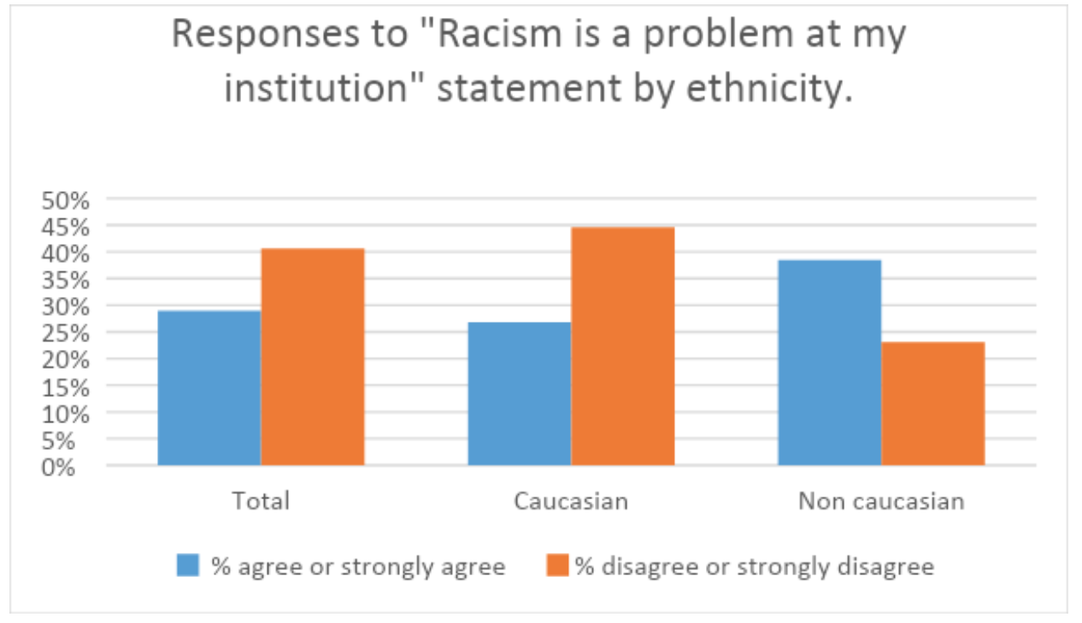
Question: Describe three findings from the data (3 marks)
Do Now
Reminders:
Phones away
Bags on floor
Books out
Pens out
Whiteboard

Slide 2
Twin & Adoption Studies – Fill out the table below
Do Now
Degree of Relationship | Degree of Gene Similarity (%)
MZ
DZ
Siblings
Adopted Children
Reminders:
Phones away
Bags on floor
Books out
Pens out
Whiteboard
Reminders
Test: Next Friday

Slide 3
Categorise the following data collection tools:
Do Now
 | Interviews | Likert scale | Heart rate
Subjective OR Objective
Qualitative OR Quantitative
Reminders:
Phones away
Bags on floor
Books out
Pens out
Whiteboard

Slide 4
Write 2 likert scale questions that could help measure a persons extroversion
Do Now
Reminders:
Phones away
Bags on floor
Books out
Pens out
Whiteboard

Slide 5
Chloe is a personal trainer at Gold’s Gym. Although she has always officially led a “straight edge” lifestyle and denounced the use of anabolic steroids, she’s always secretly wondered if they helped people get significantly stronger. She decides to find out. She purchases some steroids off the black marker from her dealer Jiggy and convinces half of her clientele at the gym to start injecting. This continues for thirty days while Chloe keeps a journal of how much weight each person in the two groups can squat. At the end of the month she compares the results.
Do Now
Identify the:
1. IV and DV
2. Experimental group and Control group
Write an operationalized hypothesis for this scenario
Reminders:
Phones away
Bags on floor
Books out
Pens out
Whiteboard

Slide 6
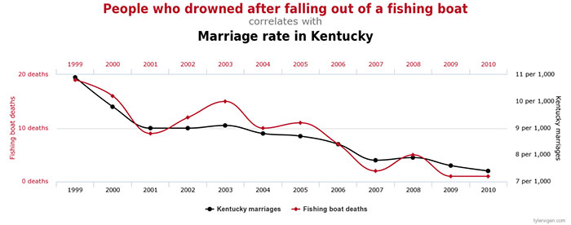
1. How many fishing boat deaths were there in 2004? 2. Describe the correlation between the years 1999 to 2001.
Do Now
Reminders:
Phones away
Bags on floor
Books out
Pens out
Whiteboard

Slide 7

Success Criteria
Learning Intention
By the end of the lesson I will be able to:
Skim read journal articles and outline the research
Know the challenges and milestones for a 5 year old
I will outline 1 twin/adoption studies.
I will be able to describe a case study of one of the children in life at 5

Slide 8
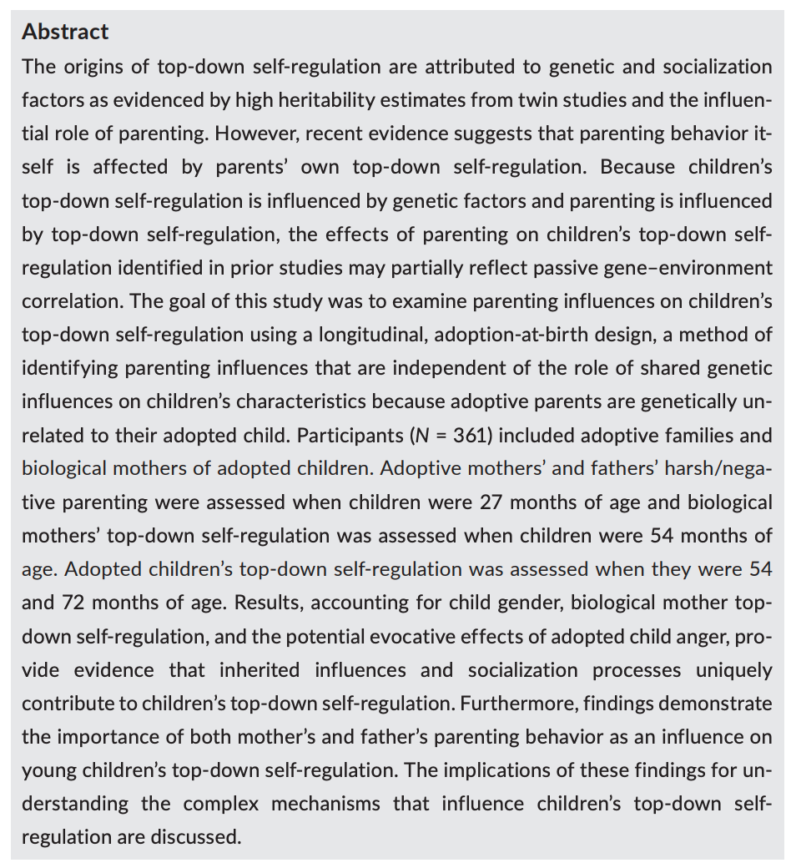
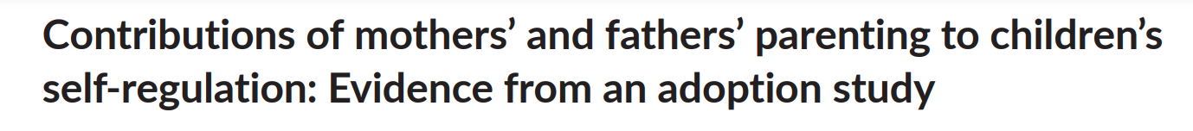
Skill: Skim reading and summarizing research
Skill Development – teacher led
When skim reading research papers the abstract should include most of the key information you need.
Key information to look for:
Aim
Participants
Procedure
Results
Conclusion
Author(s) and year
Tip: When you stumble on words you don’t know.
Make a note, but keep reading.

Slide 9

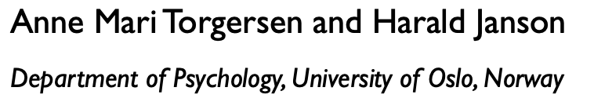
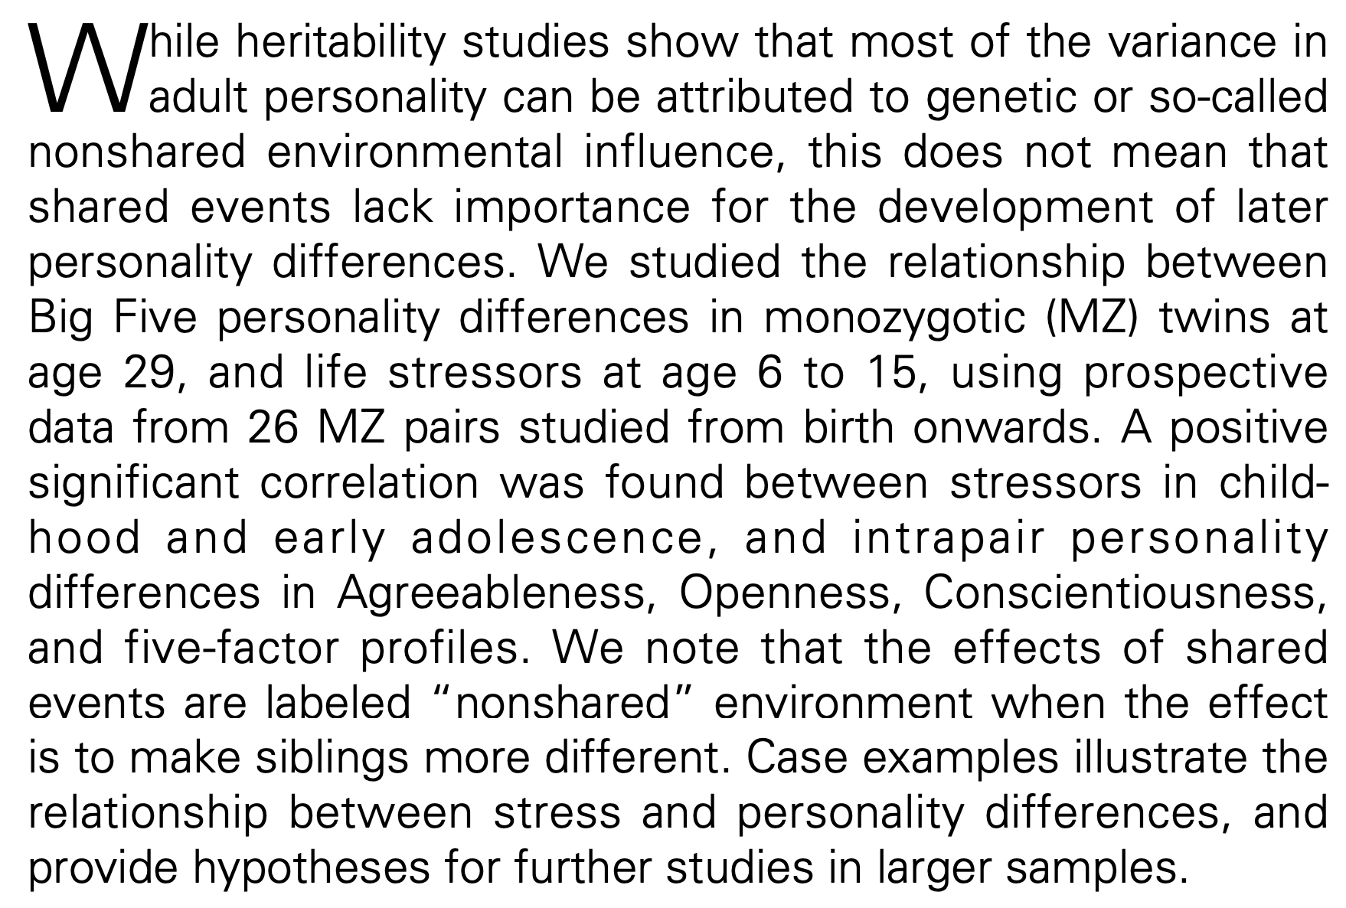
Skill: Skim reading and summarizing research
Skill Development / paired work
When skim reading research papers the abstract should include most of the key information you need.
Key information to look for:
Aim
Participants
Procedure
Results
Conclusion
Author(s) and year
Tip: When you stumble on words you don’t know.
Make a note, but keep reading.

Slide 10
The Nature and Nurture debate
25 minutes
In your groups of 3-4
You will be allocated to either the nature or nurture side of the debate.
Your task is to argue for your side. Finding research to support your arguments using twin and adoption studies.
Skim read at least two journal articles each (provided for you)
Outline one journal article using APPRC to use in your argument (and to save in your notes).
Conduct your own internet search to find supporting evidence.
Two members of your group will be asked to debate: One to present arguments (1 minute), one to rebuttal (30 seconds).
You may need evidence for IQ’s heritability in extended response answers.

Slide 11
Life at series – longitudinal series
Open your ”life at 3” document
What are the questions for life at 5?

